Slide 1

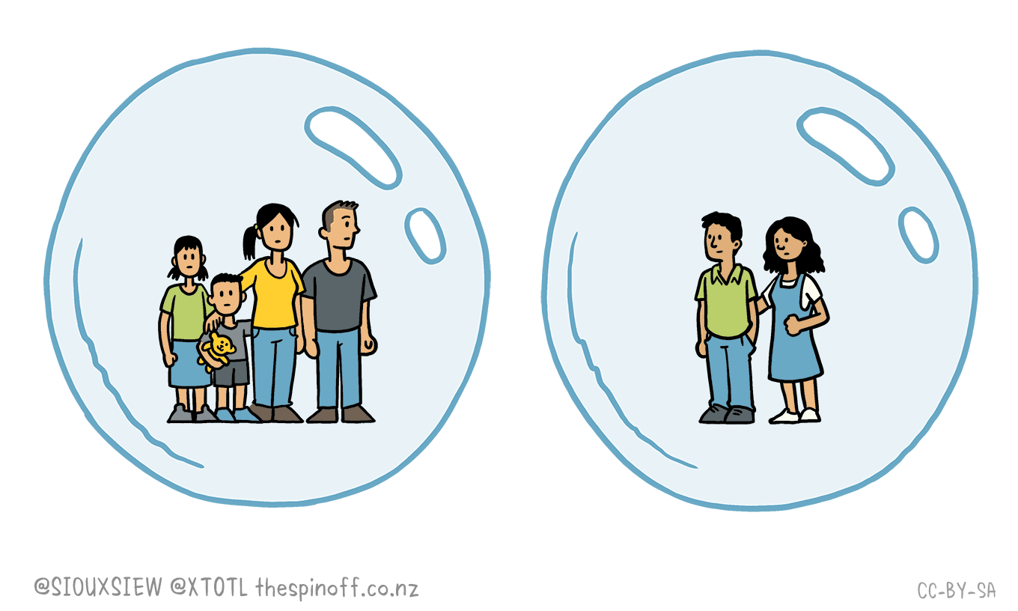

IBM Hack Challenge
COVID-19 tweets based Visualization Dashboard
Team Name : SMS (Sanitizer, Mask, Social Distancing)
Team Members : 1. Mansi Shinde
2. Sakshi Pophale
3. Simran Moondra
Mksss’s Cummins COE, Pune

Slide 2

Existing Problem -
It’s very crucial for the Government to understand the Sentiments and reactions of the country before taking any further decisions and making any new announcements.
How they’ll get to know the emotions of the Nation and the problems the people have been facing in the existing Lockdown.

Slide 3



Proposed Solution -
To solve the existing problem we’re using the tweets of people related to the current COVID crisis, to understand their sentiments and visualized them in the form of a dashboard.
It will help to predict people’s reaction to the government's decision on extension of lockdown.
The graph generated by the dashboard will help the government to take better decisions during this pandemic.

Slide 4




Software Design Challenges -
Python with tweepy to extract tweets
Using python tools to build dashboard
Vador and Text lob for Sentiment Analysis
Challenges
We thought of going ahead to trying a new tool i.e Node red

Slide 5

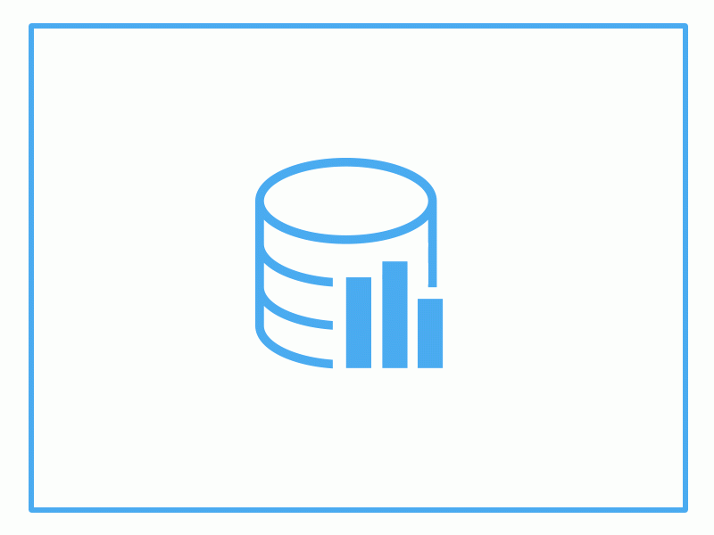

Implementation Flow -
Analysis Dashboard
Watson Chatbot
Giving Covid19 Details
Extracting tweets from twitter
Storing top tweets on Cloudant
Using Node red to create analysis dashboard
LIVE tweets
LIVE tweet sentiment/ Hr
Emotion count based on tweets
Top 5 recent tweet
Chatbot
Analysis chart for major affected cities and states
Top updates by WHO and Ministry of Health
About us

Slide 6

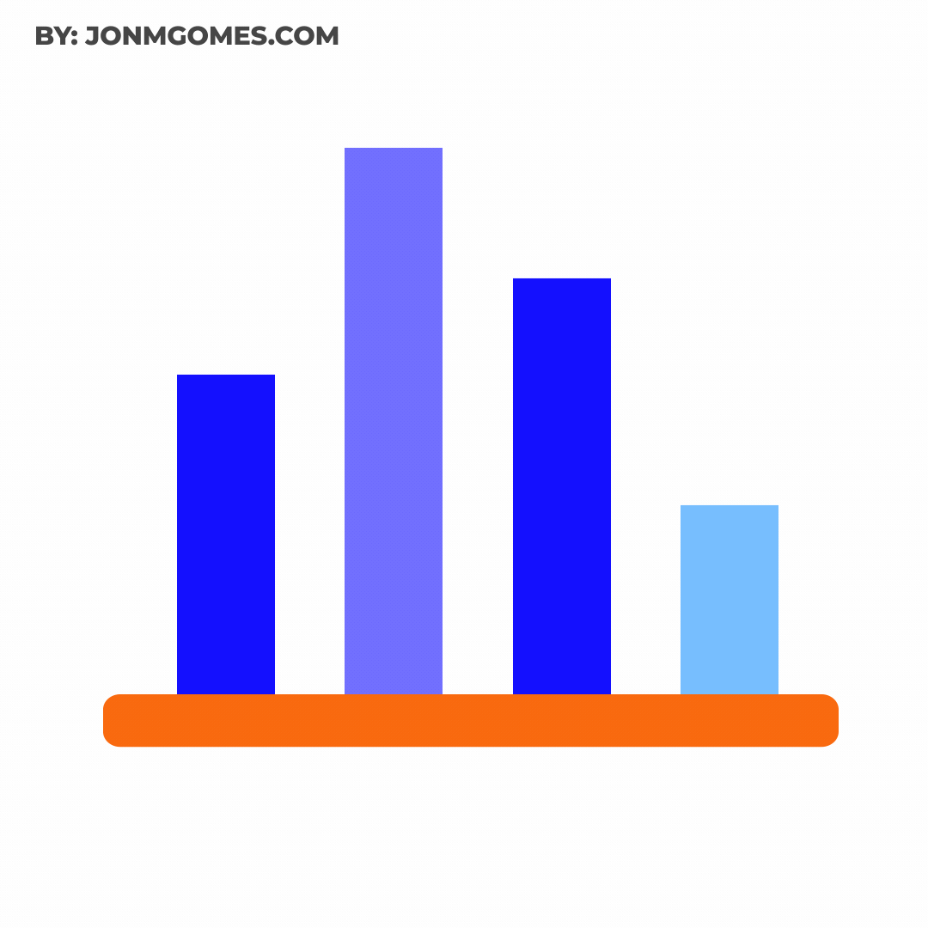
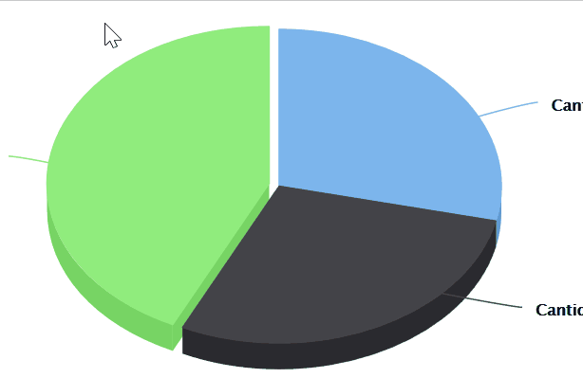
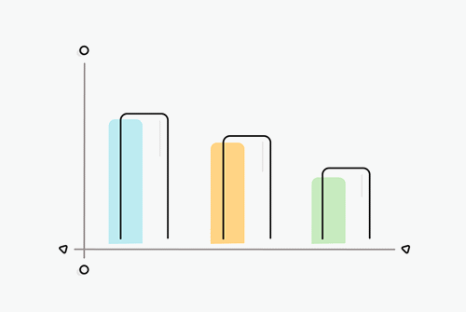
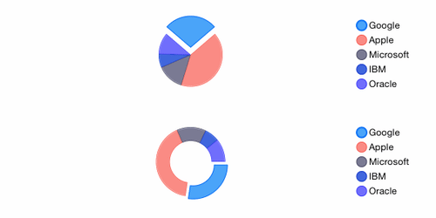
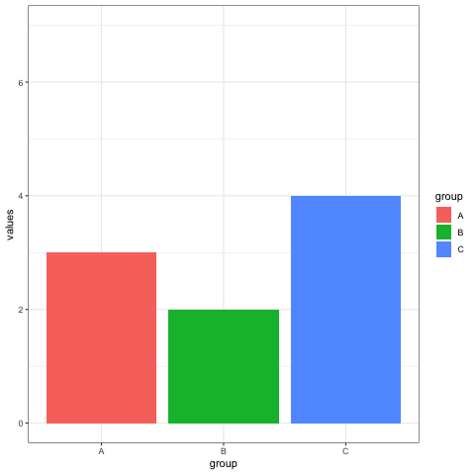

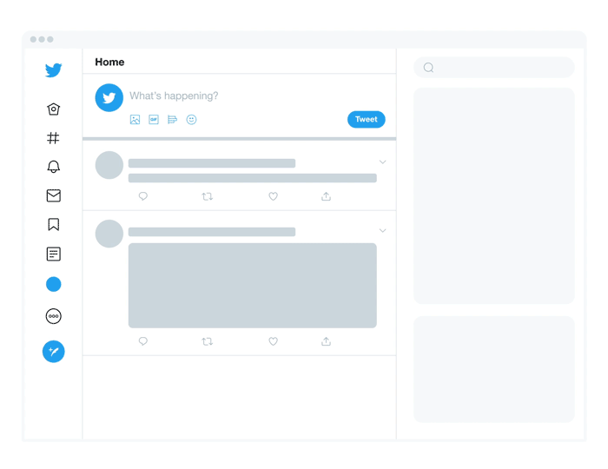
Project Explanation -
Tweet Scoreboard
Tabs
Major cities
Major States
Important Updates
About us

Slide 7

Demo of our Solution -
Flow Link :https://teamsms.eu-gb.mybluemix.net/red/#flow/c5065f3a.48774
Solution Link : https://teamsms.eu-gb.mybluemix.net/ui/#!/0?socketid=8MzV24LaifwIXTOoAAAD
Youtube Link : https://youtu.be/wlh0sCmyJKY

Slide 8
Q & A

Slide 9
Thank You!

